Slide 1

Exploring the Relationship Between NYC Restaurant Inspections and Yelp Ratings
By: Mushfiq alam, luca savarese, maria segarra
Notes:
Welcome! Our project is ‘Exploring the Relationship Between NYC Restaurant Inspections and Yelp Ratings,’ presented by Group 2: Mushfiq Alam, Luca Savarese, and Maria Segarra.

Slide 2
Contributions: Mushfiq Alam
Defined Information Architecture
Defined Data Architecture
Transformed Data on Google Collab
Loaded to Azure Storage
Notes:
Our team worked collaboratively, with each member contributing to data analysis, cleaning, integration, and visualization.

Slide 3
Contributions: Luca Savarese
Cleaned Data via Python
Created Visualizations
Managed Github Repository
Notes:
Our team worked collaboratively, with each member contributing to data analysis, cleaning, integration, and visualization.

Slide 4
Contributions: Maria Segarra
Designed the dimensional model and project structure
Assisted with data organization and integration
Notes:
Our team worked collaboratively, with each member contributing to data analysis, cleaning, integration, and visualization.

Slide 5
Project Goal and Importance
Goals
Analyze the correlation between NYC restaurant health inspection violations and Yelp ratings
Integrate NYC Open Data and Yelp datasets to uncover insights on consumer behavior and health compliance
Importance
For Consumers: Provide diners with information on health standards and ratings
For Restaurants: Provide insights to enhance compliance and customer experience
For Policymakers: Highlights the connection between health violations and public perception to guide future regulations
Notes:
Our project examines the correlation between NYC health inspection violations and Yelp ratings by integrating NYC Open Data and Yelp datasets. This work benefits consumers, who can make informed dining choices; restaurants, which gain insights for improvement; and policymakers, who can refine health regulations.

Slide 6
Requirement Details
Functional Requirements
Collect and integrate data from NYC Open Data, and Yelp
Perform data cleaning and preparation
Analyze correlations between health inspection violations and Yelp ratings
Store processed data for efficient querying and analysis
Data Requirements
NYC Open Data: Restaurant inspection records (violations, grades, locations)
Yelp Dataset: Consumer reviews
Notes:
The functional requirements included cleaning and analyzing this data to uncover trends, storing it efficiently, and visualizing insights. Our key data sources were health inspection records from NYC Open Data and consumer reviews from Yelp.

Slide 7
Business Personas
Restaurant Owners/Managers
Use insights to understand how health violations impact customer reviews and make data-driven decisions to improve operations and compliance
Consumers/Diners
Access information to make informed dining choices based on health inspections and Yelp rating
Health Inspectors
Analyze trends in violations and public perception to enhance health policies and enforcement strategies
Notes:
This analysis helps three groups: Restaurant owners to improve operations and compliance Diners to make informed choices
Health inspectors to identify trends and enhance policies.

Slide 8
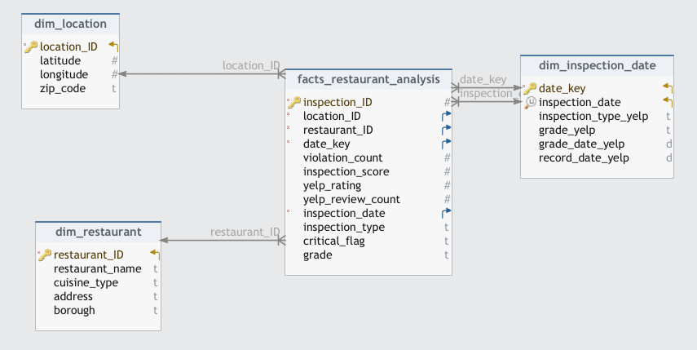
Dimensional Model
Notes:
This is the dimensional model we designed for our project. It follows a star schema structure, with the central fact table, facts_restaurant_analysis, surrounded by dimension tables: dim_location, dim_restaurant, and dim_time.
The fact table contains key metrics such as the number of violations, inspection scores, Yelp ratings, and review counts, along with inspection details like dates and critical flags.
The dimension tables provide descriptive information:
dim_location includes latitude and longitude for geospatial analysis.
dim_restaurant captures restaurant-specific details like name, cuisine type, address, and borough.
dim_time enables time-based analysis with attributes like year, month, and day.
This structure ensures efficient querying and supports detailed analysis of health inspections and Yelp ratings across various dimensions, such as location, restaurant type, and time.

Slide 9
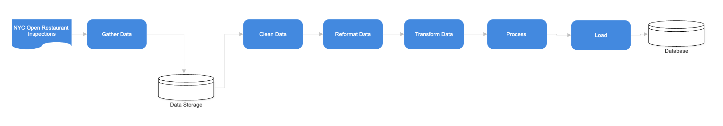
Information Architecture
Notes:
This diagram represents the information architecture for our project, showcasing the data flow from collection to storage and analysis.
Data Source: The process begins with the NYC Open Restaurant Inspections dataset, which contains detailed information about restaurant health inspections.
Gather Data: Data is collected using APIs and downloaded into our system for further processing.
Clean Data: At this stage, we handle missing values, remove duplicates, and ensure consistency across datasets.
Reformat Data: The data is then reformatted to align with the dimensional model and make it analysis-ready.
Transform Data: Key transformations are applied to derive meaningful metrics and prepare data for integration.
Process: The processed data is prepared for loading into the final storage system.
Load: The cleaned and transformed data is loaded into a SQL database for efficient querying and visualization.
This architecture ensures a streamlined workflow, making the data ready for analysis and insight generation.

Slide 10
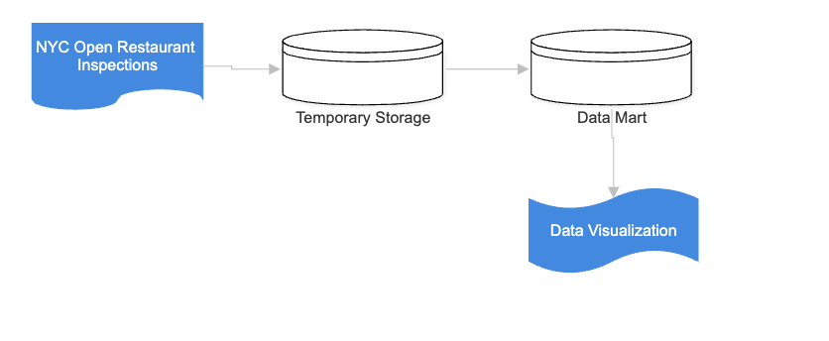
Data Architecture
Notes:
This diagram illustrates the data architecture used in our project, highlighting the flow from raw data to final visualization:
Data Source: The process begins with the NYC Open Restaurant Inspections dataset, which serves as the primary source of raw information.
Temporary Storage: The collected data is stored temporarily for cleaning, transformation, and validation. This stage ensures that raw data is prepared for downstream processes.
Data Mart: Once the data is cleaned and processed, it is organized into a structured data mart. The data mart is optimized for efficient querying and supports analysis aligned with the dimensional model.
Data Visualization: Finally, the structured data is visualized using tools like Tableau, allowing us to generate insights and present them in a clear, actionable format for stakeholders.
This architecture ensures that data flows seamlessly from source to analysis, maintaining accuracy and enabling insightful decision-making.

Slide 11
Technology Choices
Development and Data Extraction: Google Collab
Used for extracting data from APIs, including the Yelp API, and for initial data transformstions and cleaning tasks
Cloud Storage and Processing: Microsoft Azure
Used for storing and managing the cleaned dataset in SQL database and blob storage for seamless access and processing
APIs : Yelp API
Provides consumer ratings and review data for analysis
Notes:
We used Google Colab for data extraction and cleaning, Microsoft Azure for storage and processing, and MongoDB for querying. Yelp’s API provided ratings, while NYC Open Data supplied inspection records.

Slide 12
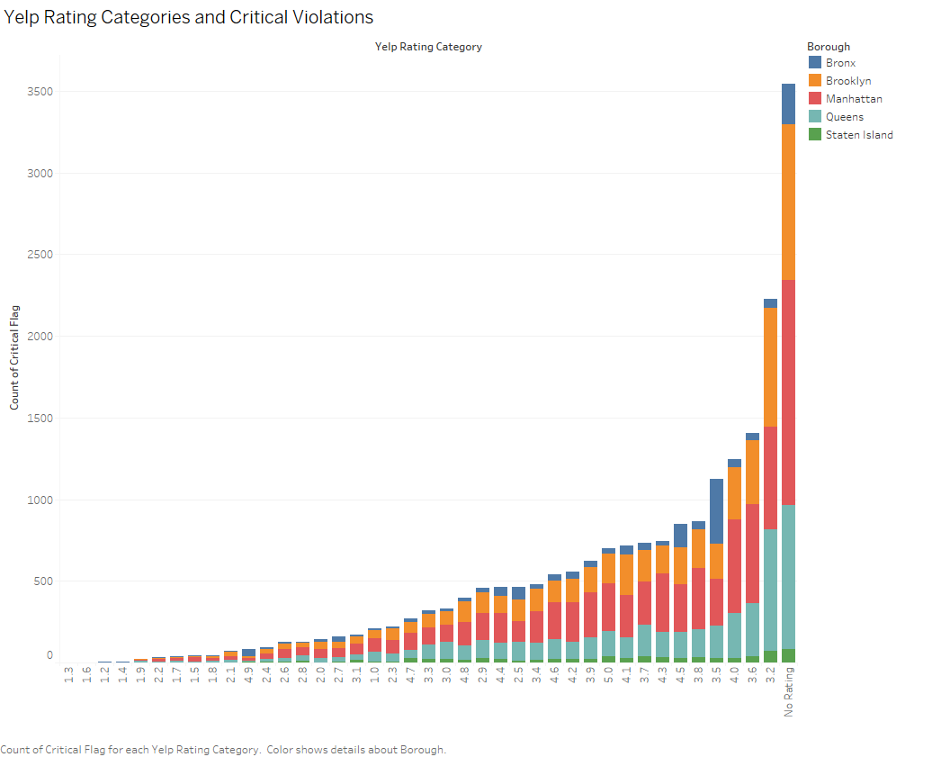
Yelp Rating Categories and Critical Violations

Slide 13
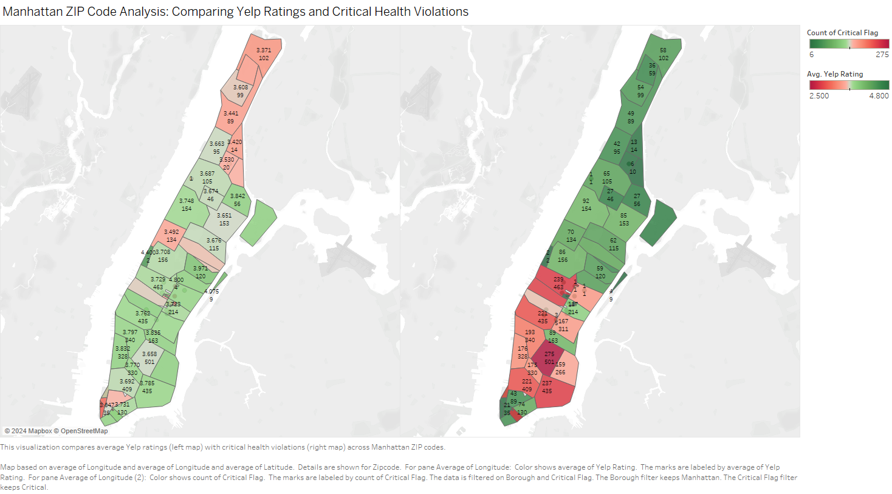
Manhattan ZIP Code Analysis: Comparing Yelp Ratings and Critical Health Violations

Slide 14
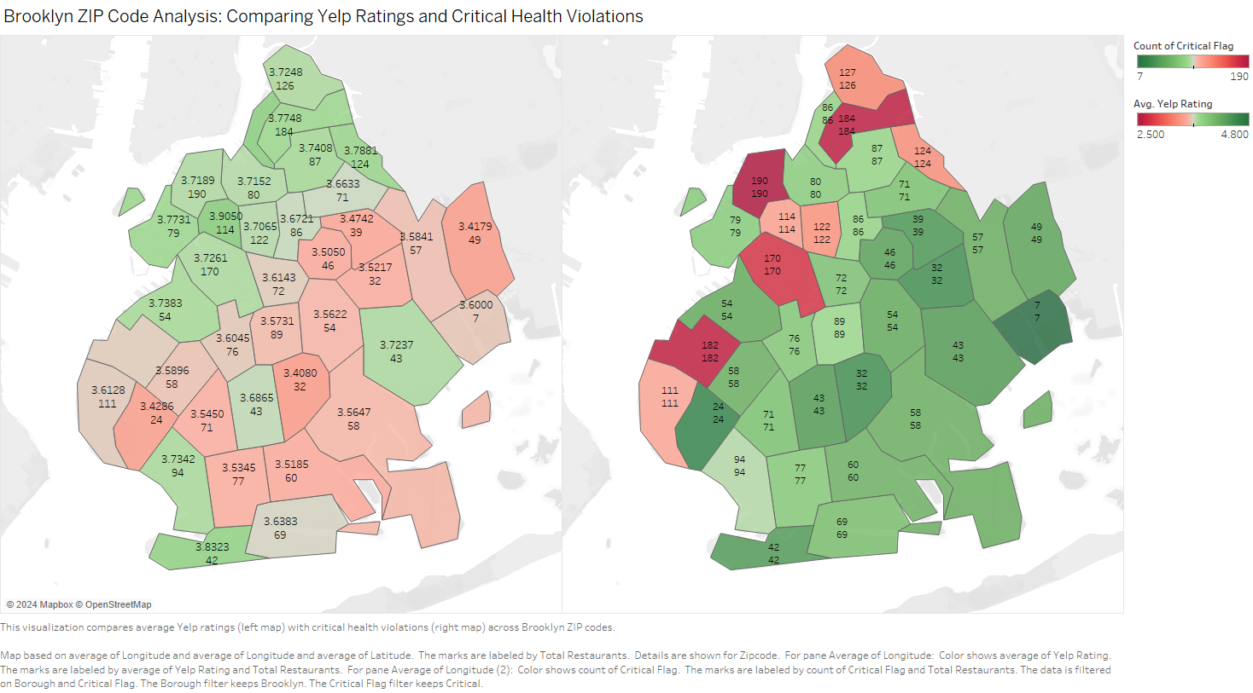
Brooklyn ZIP Code Analysis: Comparing Yelp Ratings and Critical Health Violations

Slide 15
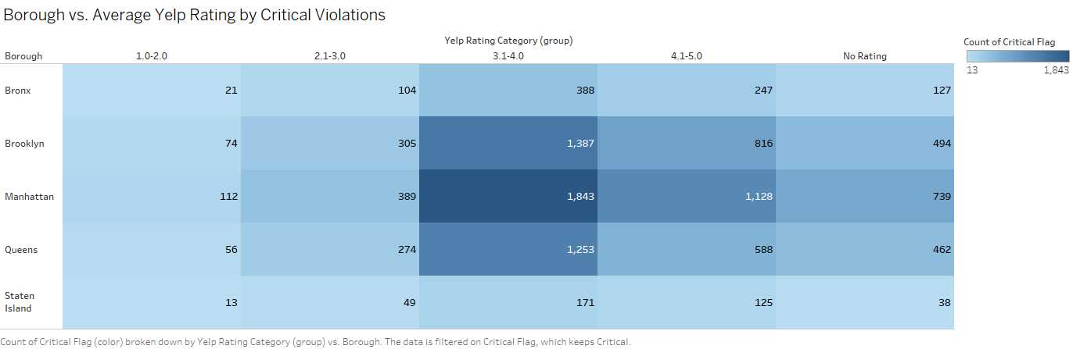
Borough vs. Average Yelp Rating by Critical Violations

Slide 16
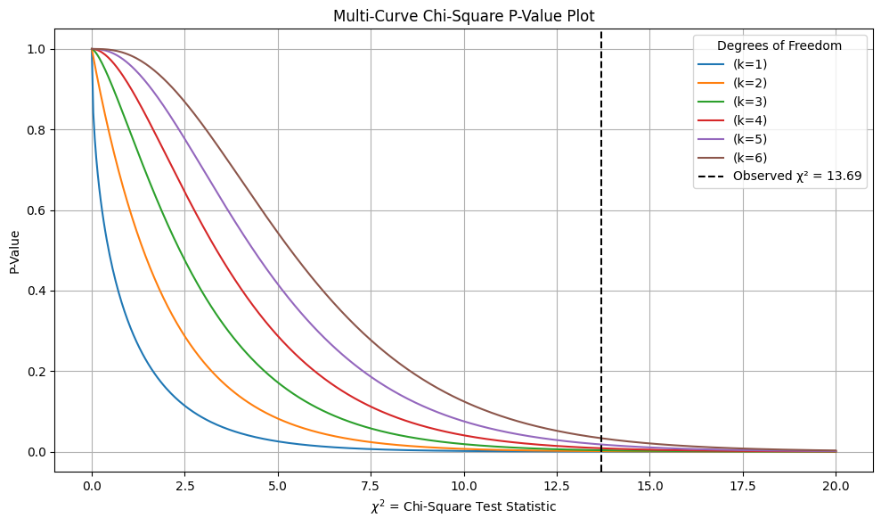
Chi Test Violations vs. Ratings

Slide 17
Conclusion
Key Findings:
Restaurants with higher critical violations tend to receive lower Yelp ratings
Geographic hotspots of critical violations are concentrated in Manhattan and Brooklyn
Discrepancies exist in mid-to-high Yelp ratings, where violations are present but may be overshadowed by factors like food quality or abundance.

Slide 18
Future Work
Future Work
Integrate Additional Resources: Incorporate reviews from other platforms to provide a broader perspective
Exploring Seasonal Trends: Analyze how inspection results and Yelp rating vary across seasons or during specific events (e.g., holidays or tourist seasons)

Slide 19
Thank you!

